Slide 1


Professor: G. Fiumara
Machine Learning Course
Department: MIFT
Course: Data Analysis (L-31)
Presented By: MohammadAmin JahaniMajd (ID: 557910)
Appliances Energy Prediction:
Nonlinear Regression with Ensemble Methods

Slide 2
Project Introduction:
This project focuses on predicting household appliance energy consumption, measured every 10 minutes, using environmental, temporal, and indoor sensor data. The dataset, collected over 4.5 months from a low-energy house in Belgium, includes details like indoor temperature and humidity, outdoor weather conditions, and time-derived features.
The target variable, appliance energy (Wh), is continuous with high variability and occasional spikes. Initial exploratory analysis reveals weak linear correlations, but strong nonlinear patterns influenced by factors such as temperature comfort ranges and daily routines. This complexity necessitates the application of nonlinear regression models for accurate predictions, as linear models are insufficient.

Slide 3
Project Workflow: 1. The Big Picture
1
2
3
DATA CONTEXT
THE GOAL
METRICS
Source & Scope
Predictive Modeling
Key Data Features
Appliance energy data was collected from a low-energy house in Belgium over a period of 4.5 months, with readings recorded every 10 minutes.
Our objective is to construct a robust model capable of predicting appliance energy consumption. This model will leverage environmental data from an outdoor weather station and indoor readings from Zigbee sensors.
Appliance and Lights energy consumption (Wh)
Indoor temperature and humidity for each room
Outdoor weather data (temperature, pressure, humidity, wind speed, visibility, dew point)
Date and time attributes
Two synthetic random variables
This comprehensive dataset allows us to explore complex interactions between various factors influencing household energy use, providing a strong foundation for our nonlinear regression analysis.

Slide 4



2. Framing the Prediction Problem
The Core Objective
Modeling Approach
Target & Learning
Our primary goal is to accurately predict household appliance energy consumption, measured in Watt-hours (Wh), for every 10-minute interval.
We'll use a supervised learning framework, focusing on non-linear regression due to weak linear correlations. Ensemble methods will ensure high predictive precision.
The target variable is continuous, representing a wide range of energy values. Utilizing our static dataset, we will employ batch learning for model training.

Slide 5
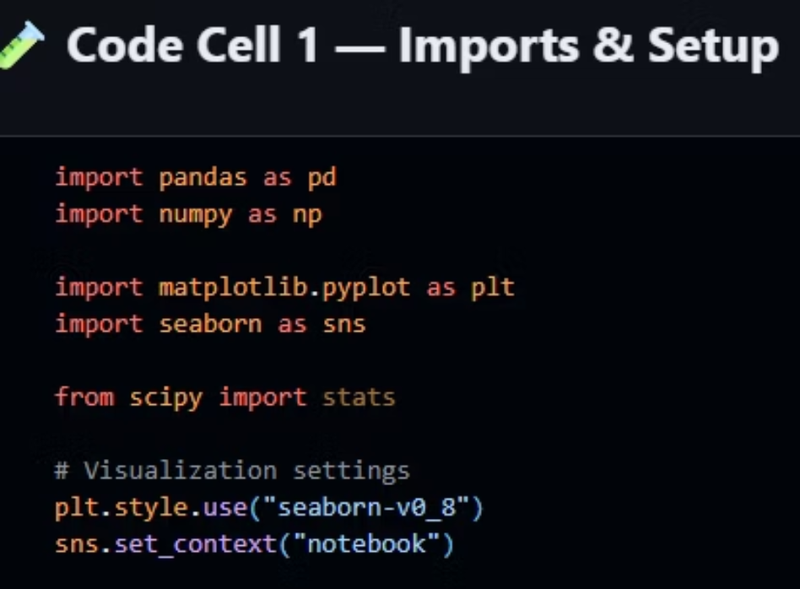
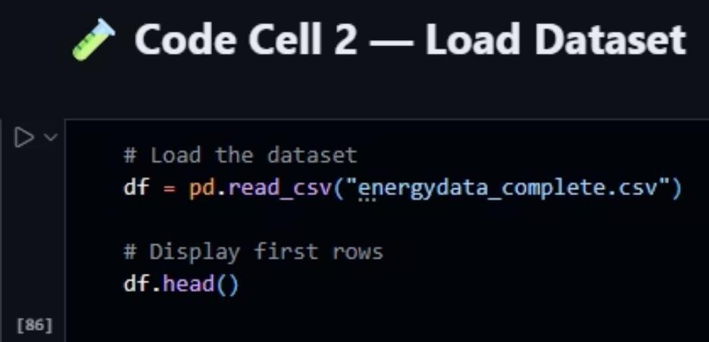
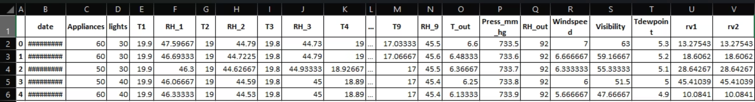
3. Data Mining
First we import our libraries , then we load the data as df (DataFrame) with pandas library and checkout the top part of dataset table by df.head()

Slide 6
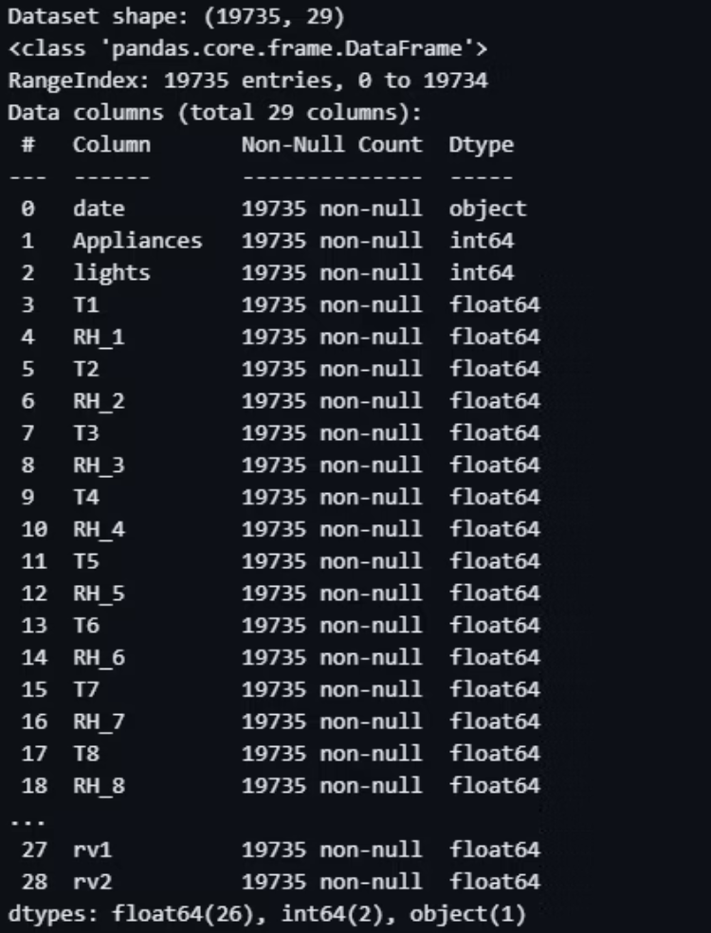
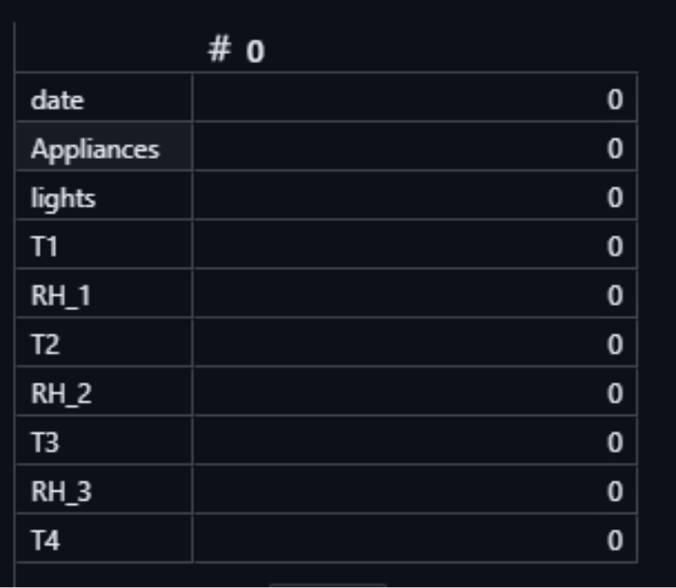
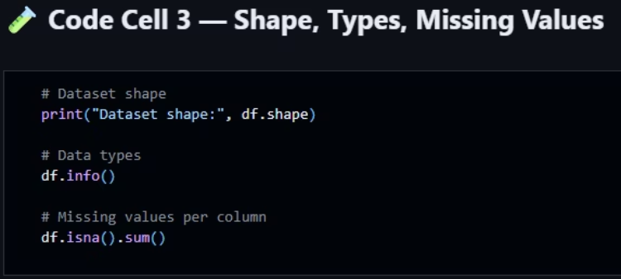
3. Data Mining
Then we check the table shape with print(df.shape) that return (19735, 29) which indicate number of captured data rows and feature columns which are exactly same amount as dataset description .
Then we check df.info() that return new table of our dataset info which are non-Null count and Data Type for each feature.
After that we can count Null values in our table by df.isna().sum() which return nothing because our dataset does not include any Null value

Slide 7
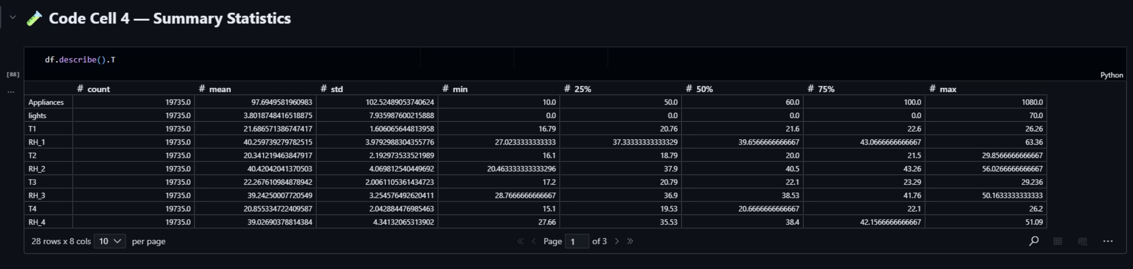
3. Data Mining
At the end we can check out the df.describe().T to see the summary statics of our data .
here we can notice that the max value of our target data appliances (1080.0) is so far away from the mean of the whole captured data for this feature (≈97.69) . its indicate that we have Outliers in this feature which need to be handle later .

Slide 8
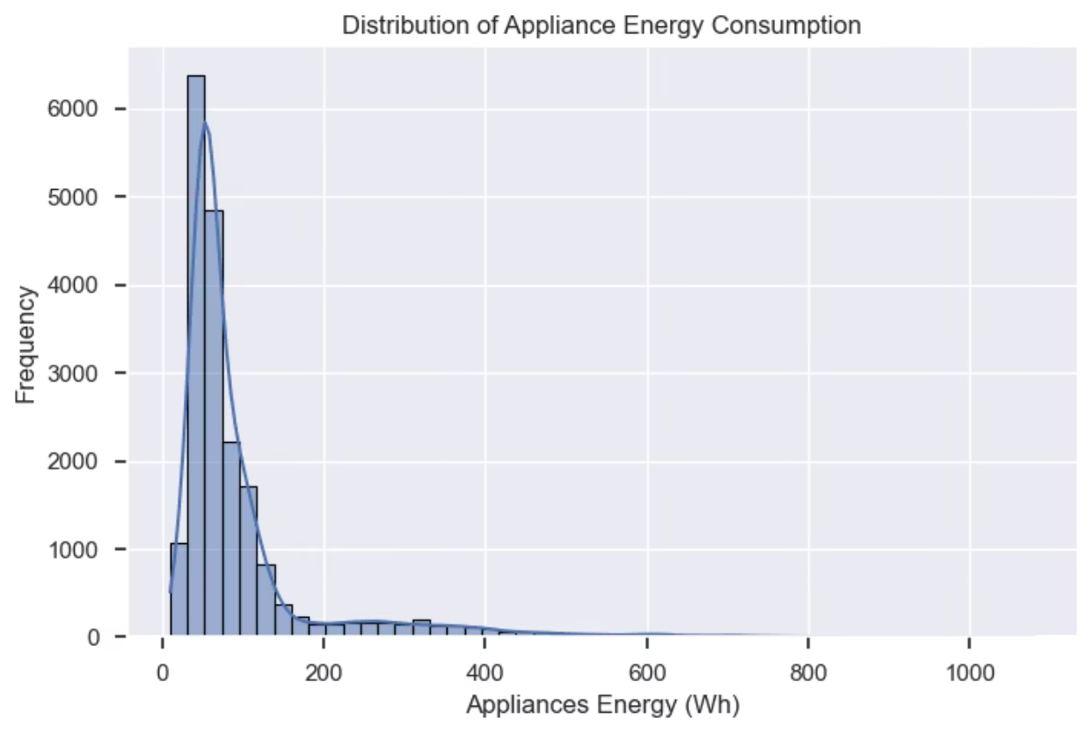
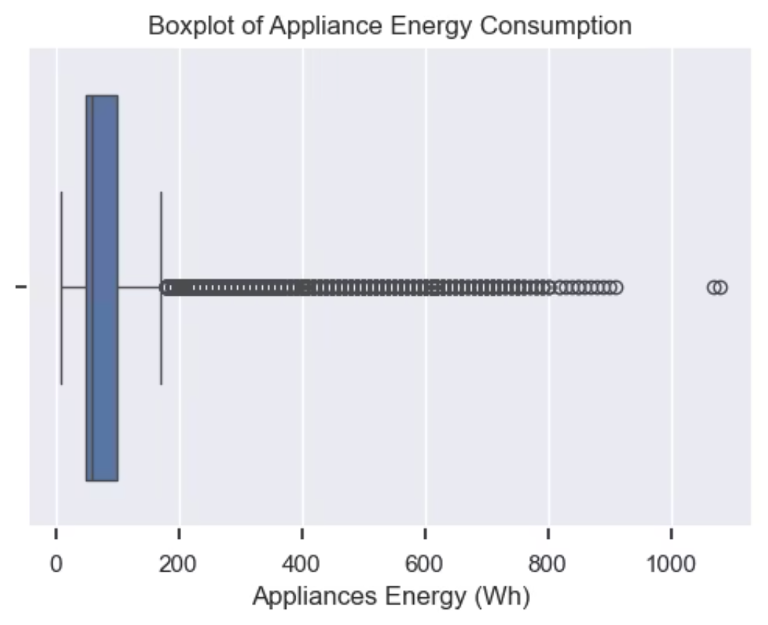
4. Target Variable Analysis
In this part we checkout our target variable Appliances in visualized method .
Then we check the target Boxplot that easily indicates the boundaries of outliers , we can see that around the 180-190 Wh energy consumption we have high boundary and after that we can see number of outliers shown by empty black dots .
First, we start with Target distribution analysis with Histogram , here we can see that we have a right-skewed distribution which need to handled later .

Slide 9
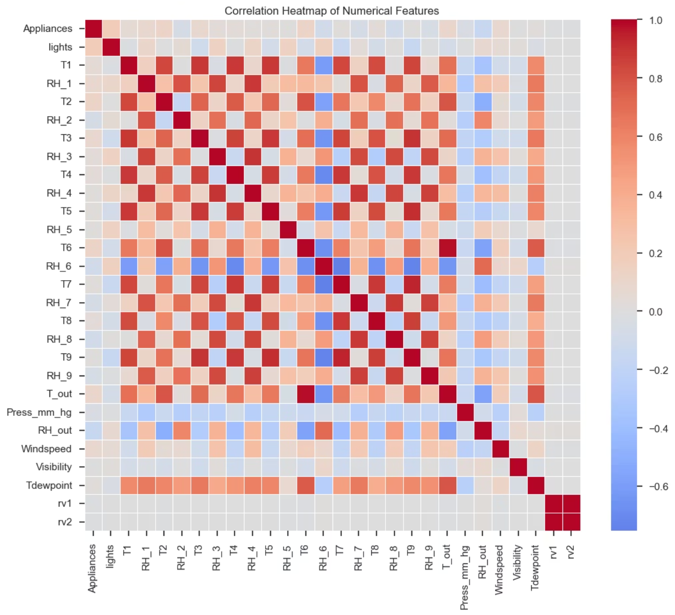
5. Relationships between predictors and target :
First of all, we need to use seaborn and matplotlib libraries to create a Correlation Heatmap , in this map we use .corr() method which shows linear relationship between features .
we can see that our target feature has no strong linear relationship with other features , we should check out for non-linear relationship patterns.

Slide 10
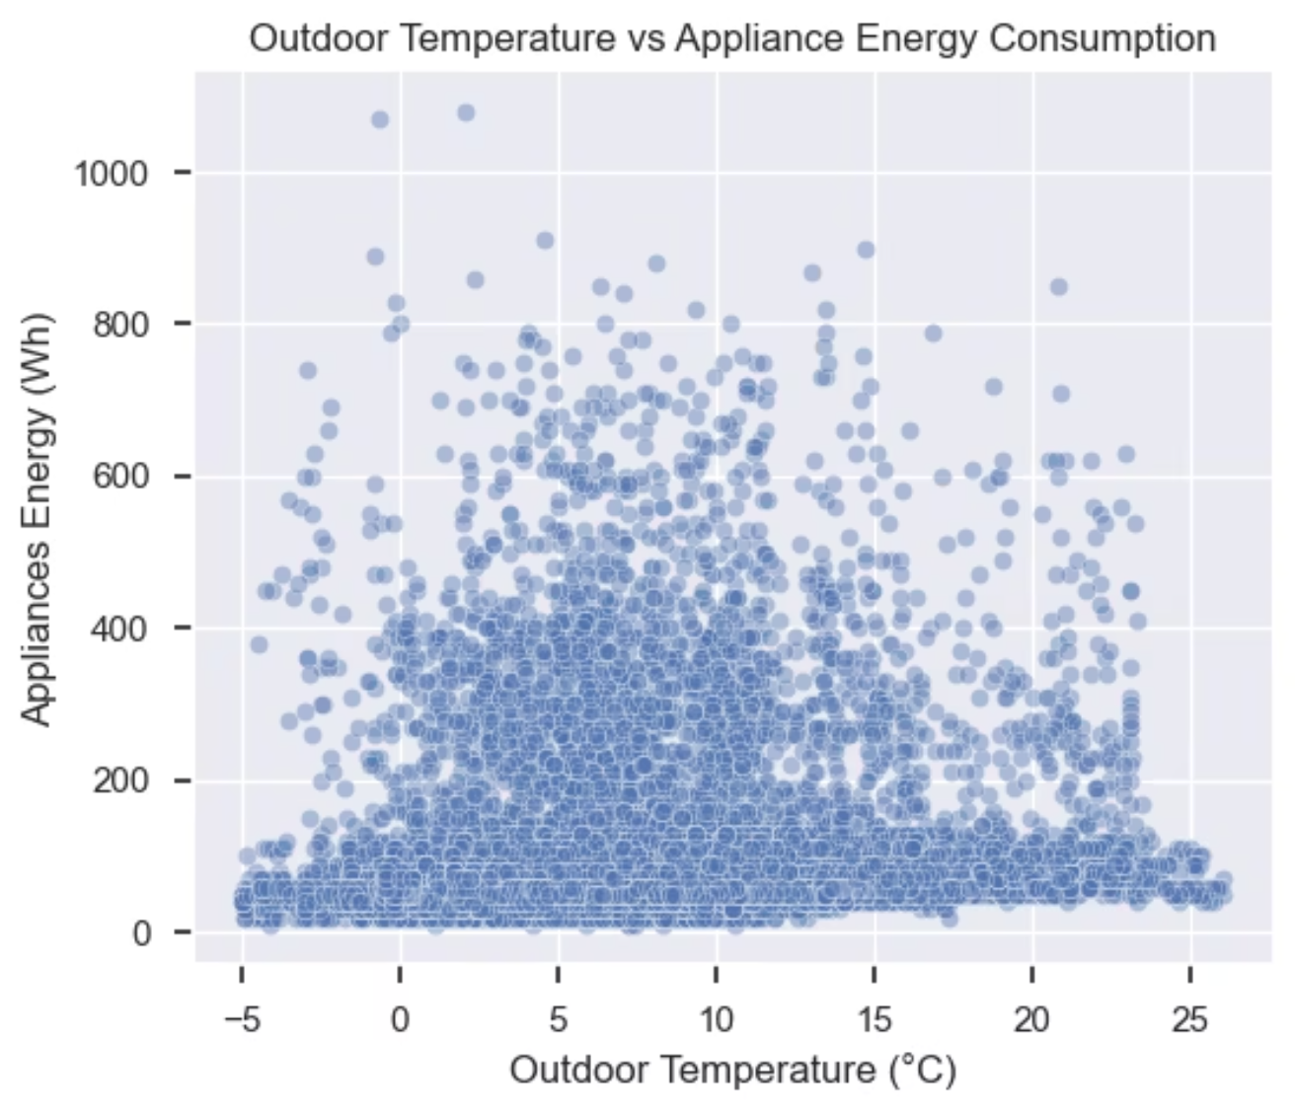
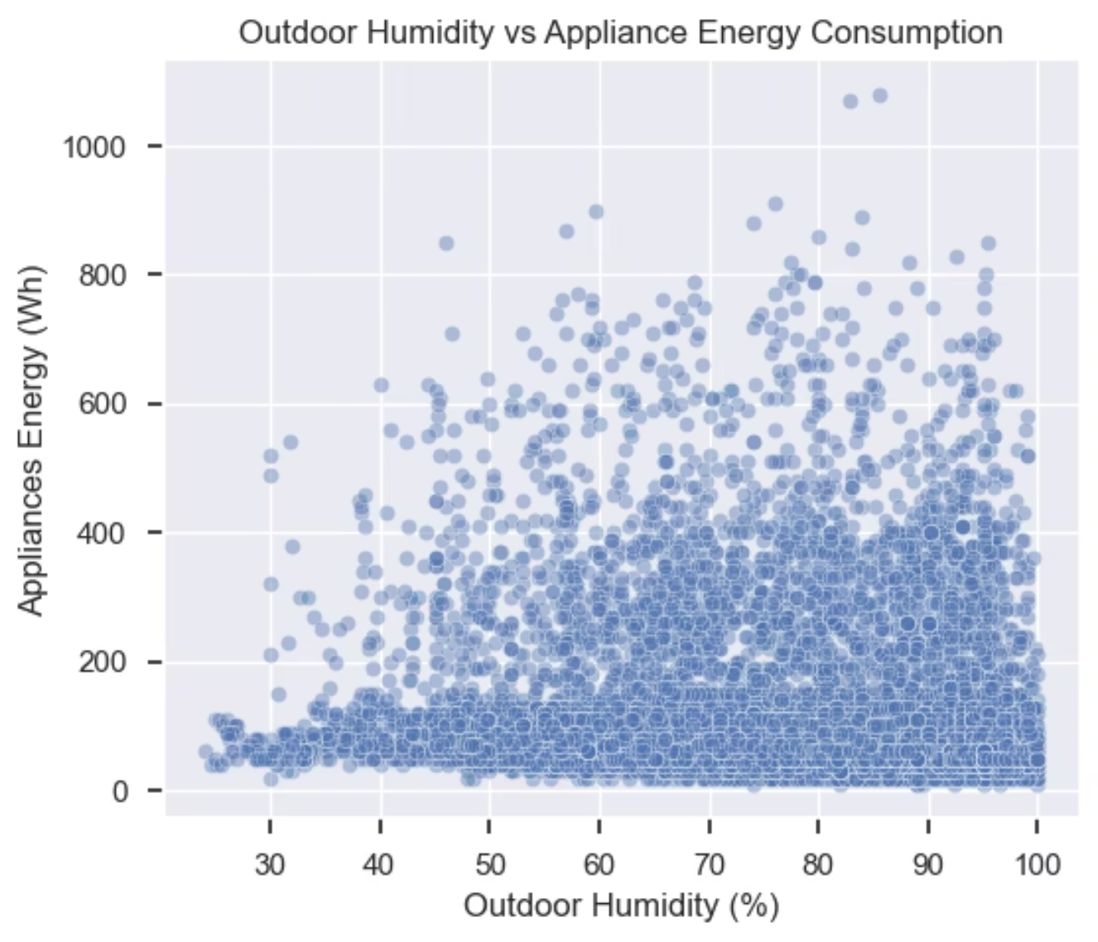
5. Relationships between predictors and target :
Now we use scatterplot for Temperature and Humidity versus our target variable , in these 2 scatterplots we can see some distribution patterns and thresholds which could be potential for non-linear relationships .

Slide 11
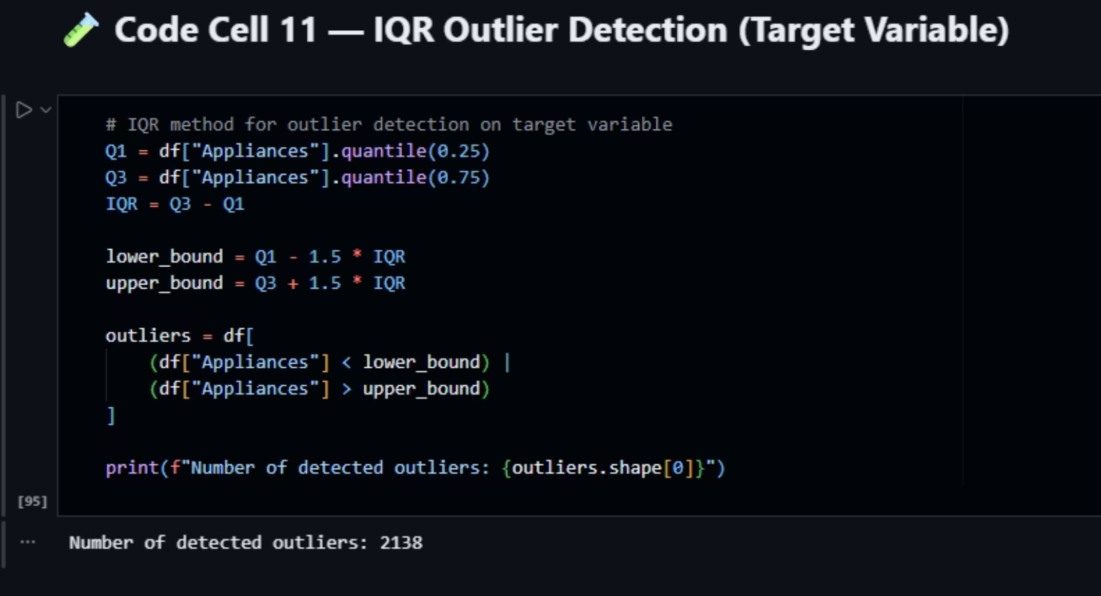
6. Data preprocessing :
our dataset have no categorical feature to handle , no missing values handle , and also no attribute combination needed .
but in jupyter notbook we check outliers and missing value one more time for more precise analysis , we can also count outliers by using Inter Quantile Range (IQR) .

Slide 12
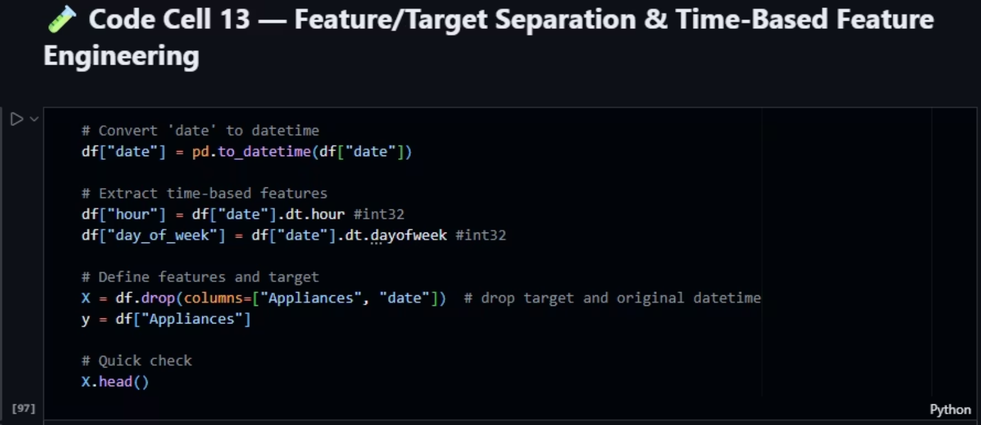
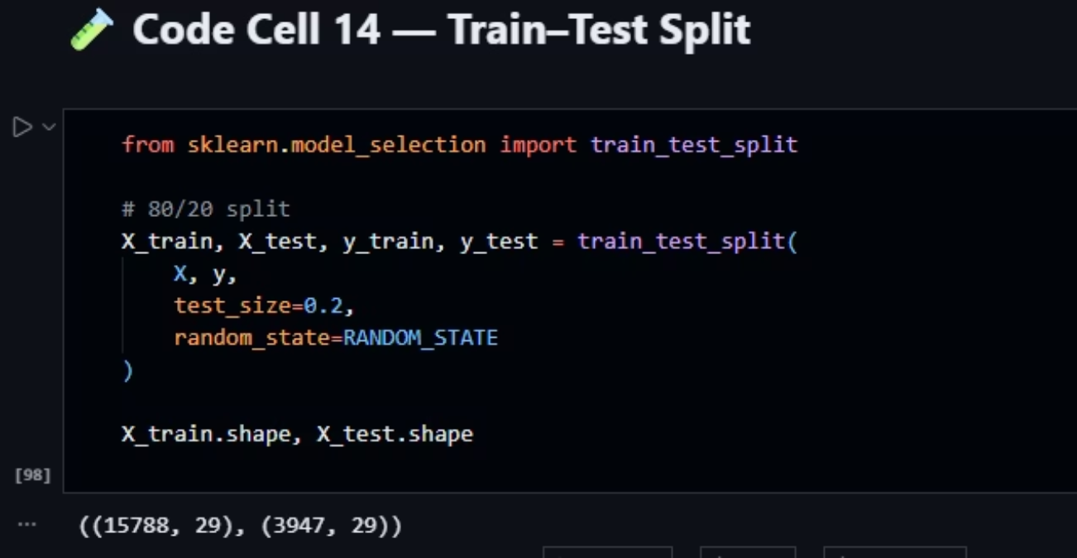
6. Data Preprocessing : Feature Scaling
In the first step of feature scaling, we change our date data type from object to 2 features with int32 data type (hour and day of weak) for further model fitting , then we define our target feature as y and other remaining predicators as X .
Now we use scikit library train-test-split method to make train and test portions (80-20) for both our predicators and target , which we can see the shape of both part to check out number of captured data in each of the train and test parts with .shape() method.

Slide 13
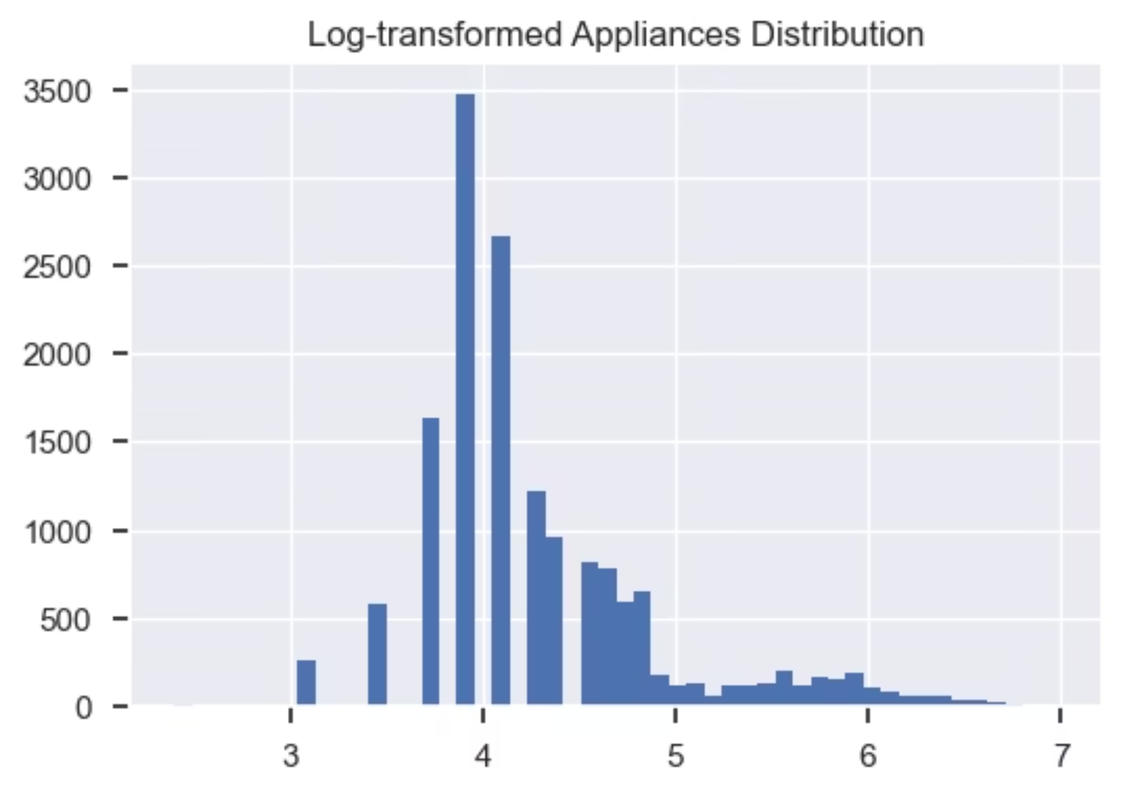
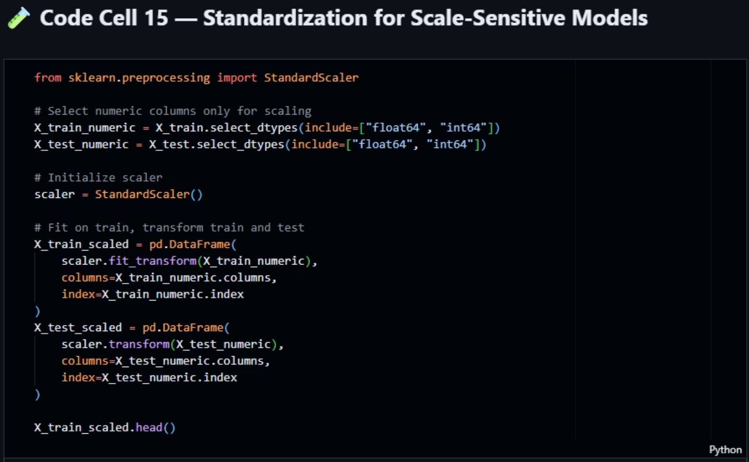
Now we apply standardization with StandardScaler of scikit library , this method uses z-score scaling to standardize the predicators train and test data for sensitive models . we Fit on train to learn parameters, transform train and test to apply the same scaling consistently and avoid data leakage .
Now we apply logarithmic transformation to the target to handle the right skewed distribution we detected earlier , we use numpy library logarithm method np.log1d(x) to perform ln(1 + x) transformation to reduce skewness .

Slide 14
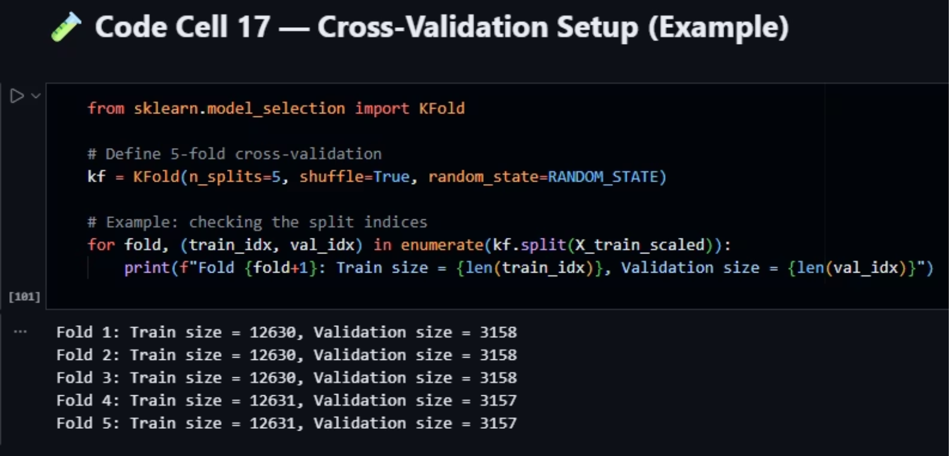
We also prepare a K-fold Cross-Validation with K = 5 to provide more stable estimate of generalization performance , we apply this K-Fold on our 80-20 split (on 80% train set) to increase performance and reduce luckiness on one split .

Slide 15
7. Model Development
In this phase, we implement and compare several machine learning models to assess their performance using statistical metrics such as RMSE, MAE, and R². Our goal is to identify the best-fitting model for our energy consumption prediction project.
Baseline Linear Regression
Support Vector Regression (SVR)
Random Forest Regressor (Ensemble)
This model serves as a fundamental reference point, helping us determine if more complex non-linear approaches provide a significant performance improvement.
We employ SVR with a Radial Basis Function (RBF) kernel, known for its ability to capture complex patterns in data by mapping them into higher dimensional spaces.
This ensemble method leverages multiple decision trees to enhance predictive accuracy and robustness, with hyperparameters carefully tuned via cross-validation.
Decision Tree Regressor
Polynomial Regression
A decision tree model configured with a maximum depth of 10 is used to capture hierarchical decision rules, offering interpretability while managing complexity.
Gradient Boosting Regressor
Utilizing GridSearchCV and PolynomialFeatures, combined with Ridge regularization in a pipeline, we explore non-linear relationships efficiently while mitigating overfitting.
Another powerful ensemble technique, Gradient Boosting builds models sequentially to correct errors of previous models, optimized through hyperparameter tuning and cross-validation.

Slide 16
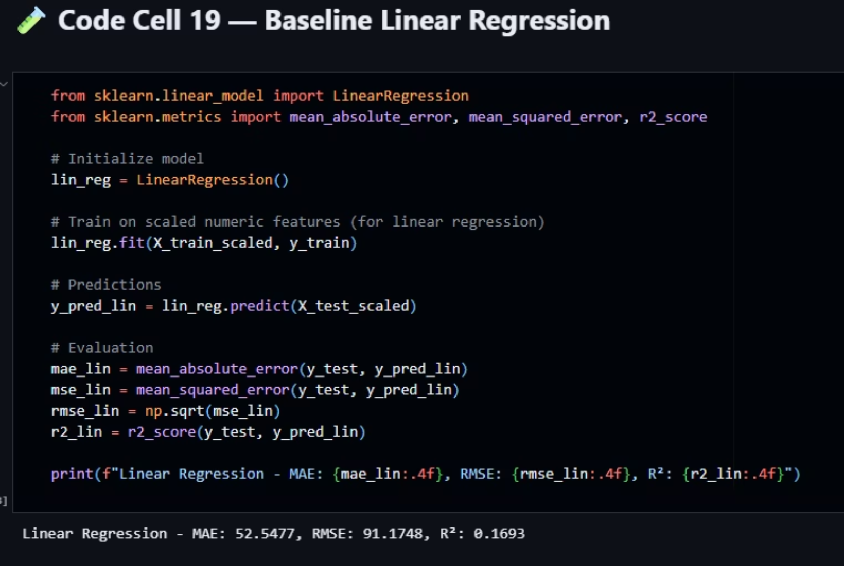
Baseline Linear Regression :
to serve as a reference to understand if non-linear models improve performance .
i. we use scikit library to import and use LinearRegression method also from this library we import the metrics we need to calculate as output of model performance and compare them with each other later .
ii. we fit model on train set of scaled predictors and train set of target feature .
iii. then we predict the target feature by test set of scaled predictors .
iv. at the end we evaluate the MAE , RMSE and R2 to measure the model performance

Slide 17
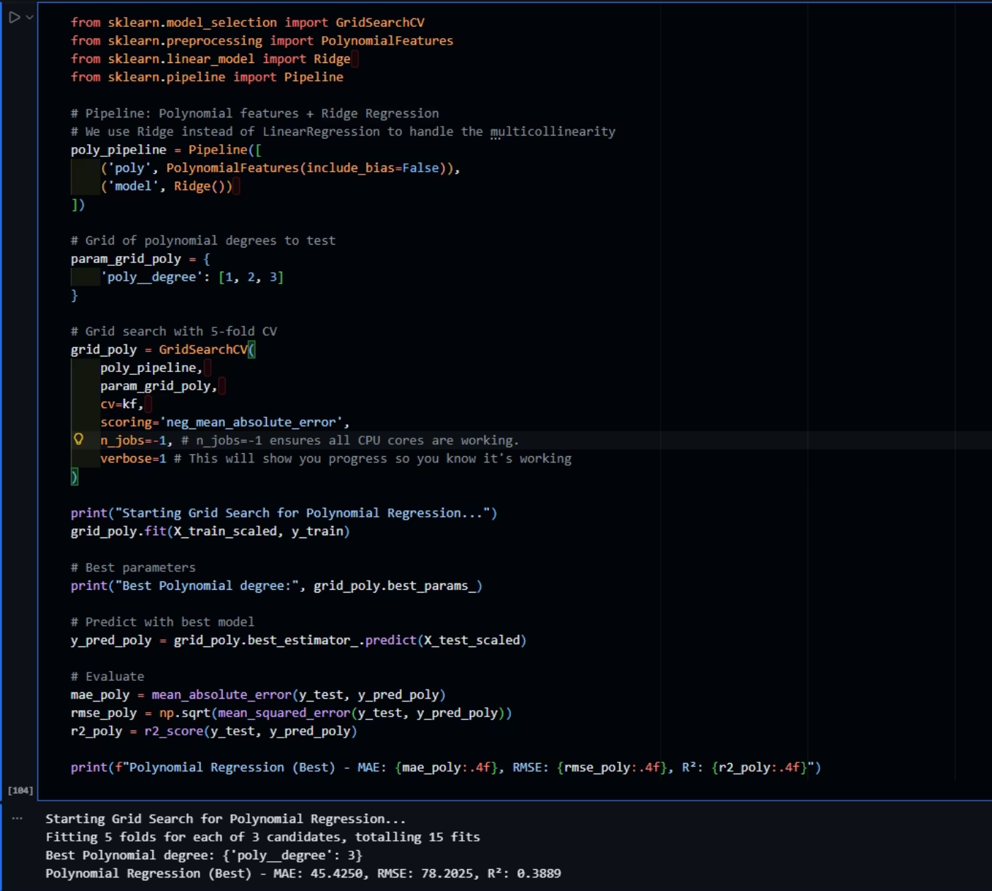
Polynomial Regression :
i. We use GridSearchCV (for searching or cross validation) , PolynomialFeatures (for our polynomial model) , Ridge (for memory efficient search and reduce overfitting using Ridge regression) ,and pipeline (for pipeline creation of transformations) from scikit library .
ii. First, we create polynomial pipeline with Ridge model .
iii. Then we set grid polynomial (hyperparameter) degree set for test , we use first 1 to 3 degree
iv. Then we apply our grid search for all our degrees and with 5-fold CV , we set the scoring to -MAE to compare due to minimizing mean absolute error , then we set n__jobs=-1 to ensure all CPU cores are working and verbose=1 to shows the progress .
v. Fit the grid polynomial to train set of scaled predicators and train set of target feature , then predict target on test set of scaled predicators .
vi. Then we evaluate metrics for best estimator chosen by Grid Search in this model .

Slide 18
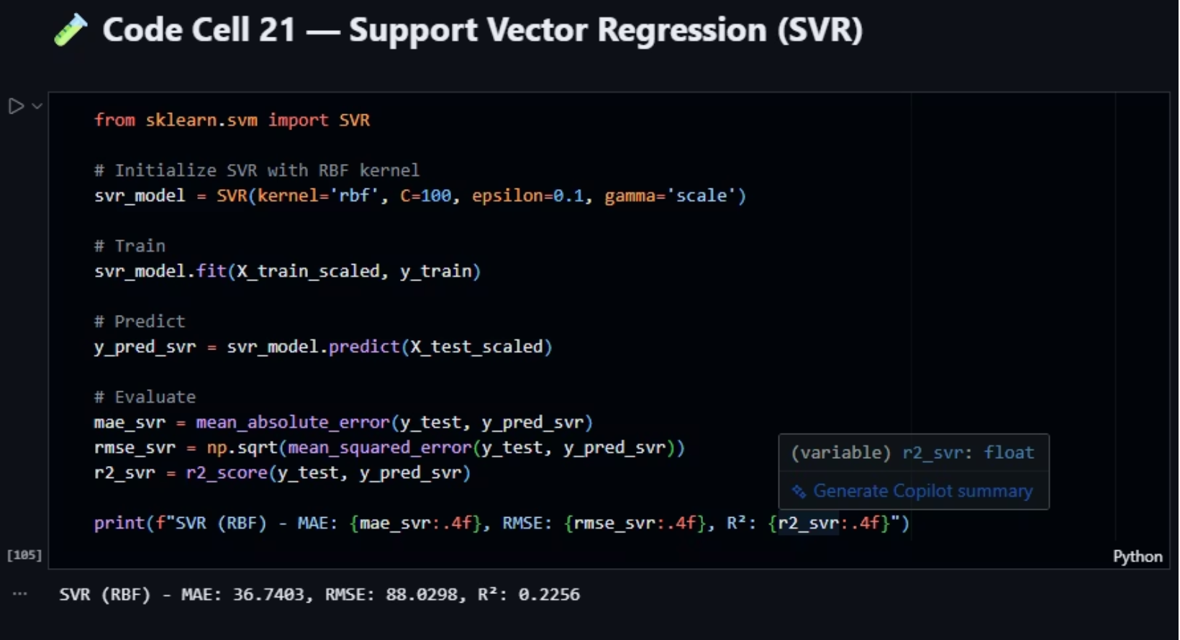
Support Vector Regression (SVR) :
i. We use SVR method of scikit learn to implement this model .
ii. We initialize our model with RBF (Radial Basis Function) kernel , we set the parameters like this : c = 100 as controls of trade-off between complexity and error , ε (epsilon) = 0.1 as width of the no-penalty zone around regression line ,and γ (gamma) = ‘scale’ to control influence of a single data point scaled.
iii. Fit the model and predict on scaled test set of predicators
iv. Evaluate error metrics

Slide 19
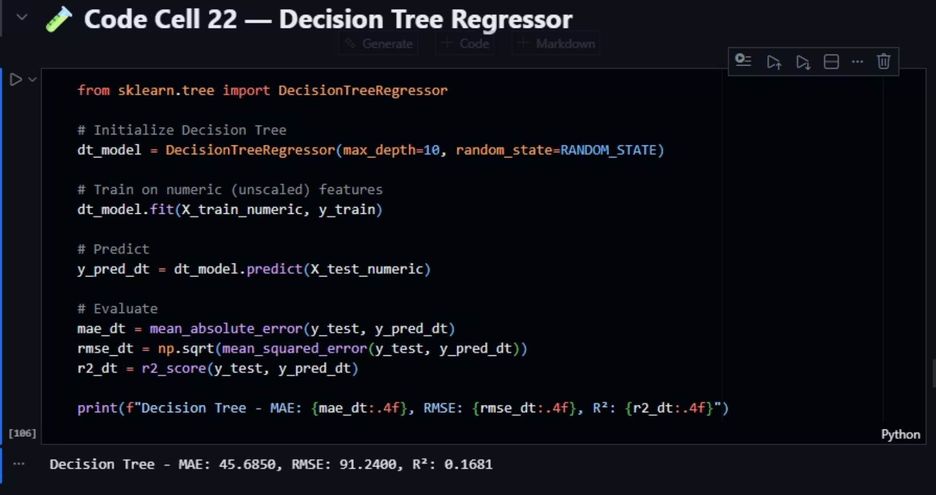
Decision Tree Regressor :
i. Use scikit DecisionTreeRegressor method to implement this model .
ii. Initialize the model with max_depth = 10 to ensure that the decision making be less than that for efficient program .
iii. Fit on unscaled train set and predict on unscaled train set of predicators
iv. Evaluate error metrics

Slide 20
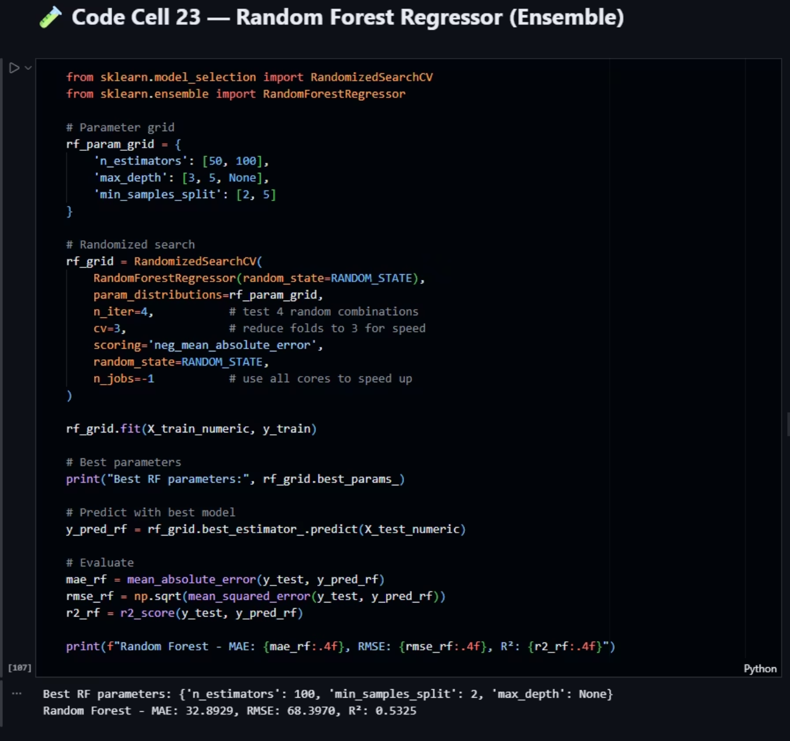
Random Forest Regressor (Ensemble) :
i. We use RandomizedSearchCV (for search between grid we define further) ,and RandomForestRegressor (to implement the model) from scikit library.
ii. We define grid parameters (hyperparameters) as : n_estimator : [50, 100] for Number of decision trees in the forest , max_depth : [3, 5, None] for defining Maximum depth of each decision tree and the None is no limitation until reach the criteria , min_samples_split : [2, 5] for Minimum number of samples required to split an internal node.
iii. Now we implement randomized search with these arguments : using model RrandomForestRegressor , using param distribution defined as hyperparameters , n_iter = 4 for test 4 random combinations , we reduce our cross validation fold here from 5 to 3 to make this program memory efficient by cv=3 , scoring = ‘neg_mean_absolute_error’ make evaluation based on -MAE , random state defining to reproducibility , and make sure all cores of cpu speed up by n__jobs=-1
iv. We fit on unscaled train set and predict on unscaled test set
v. We evaluate metrics for best estimator decided by randomized search

Slide 21
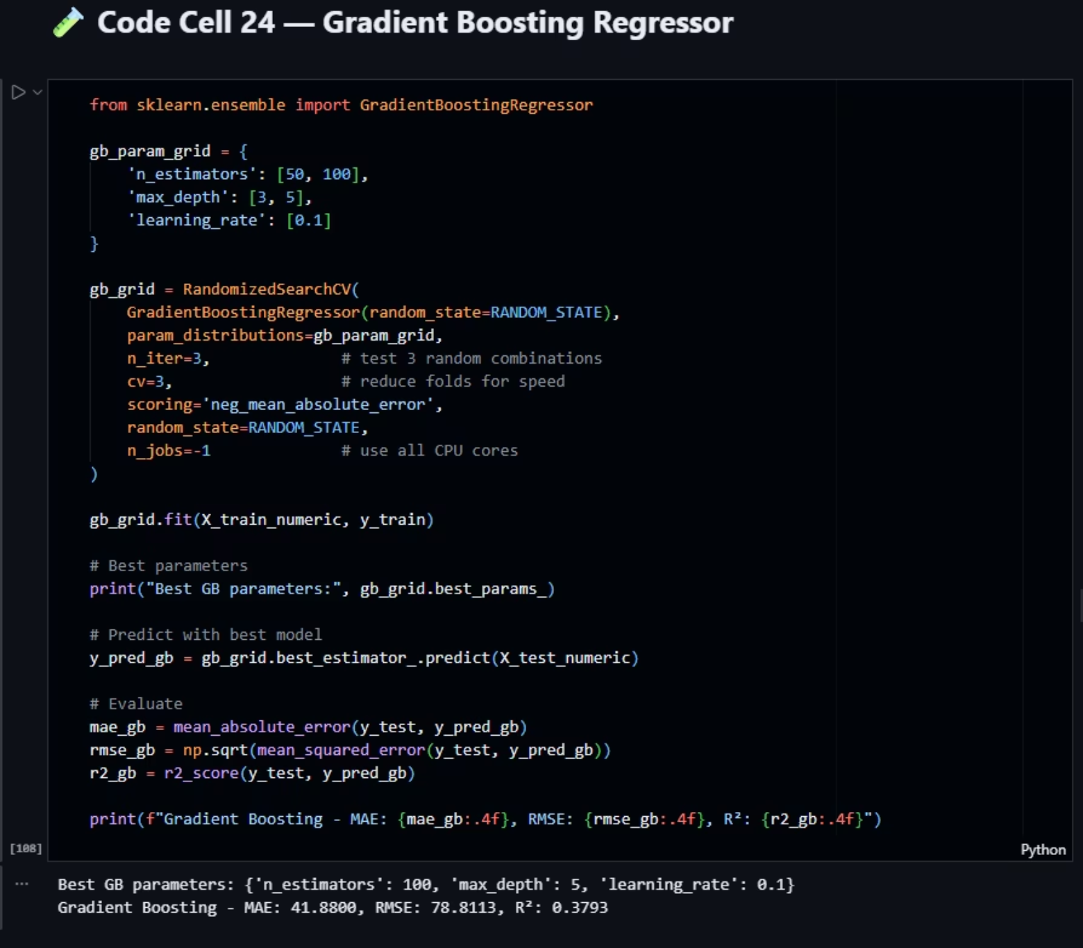
Gradient Boosting Regressor :
i. We use GradientBoostingRegressor from scikit library
ii. We set the hyperparameters with 50 and 100 number of estimators , 3 and 5 for limitation of maximum number of decision depth , and learning rate of 0.1
iii. We set RandomizedSearchCV with 3 iterations number , 3 Cross Validation fold number and GradientBosstingRegressor model
iv. We fit on unscaled train set and predict on unscaled predicators on best estimator selected by search
v. Then evaluate metrics for later comparison

Slide 22
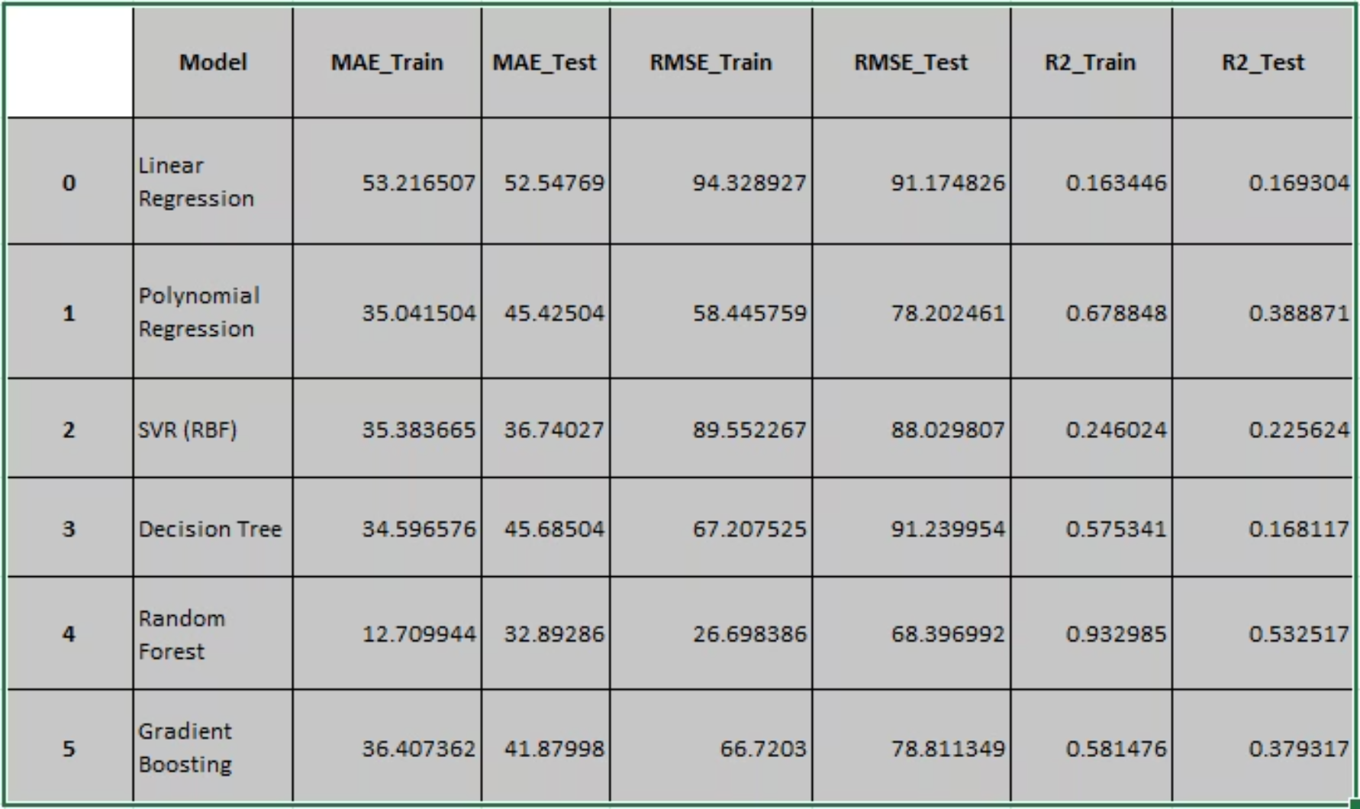
8. Model Evaluation & Comparison :
We create a metric table for All models , we can see that Random Forest have least train and test error between all models , it means that Random Forest and Gradient Boosting have best performance between all models .

Slide 23
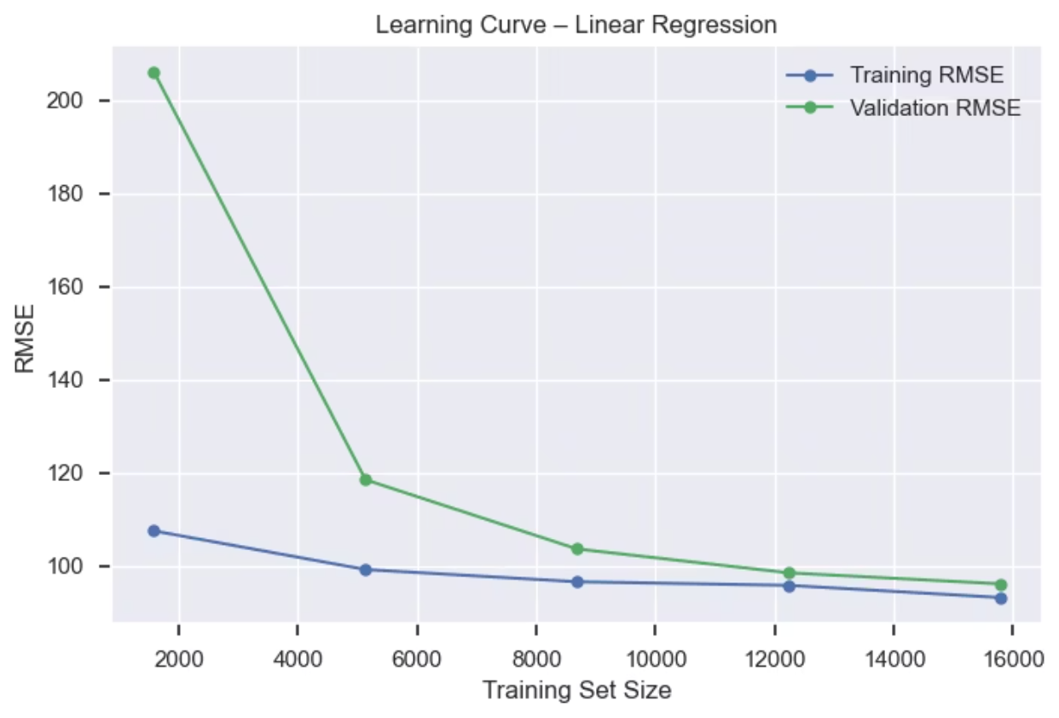
Learning Curves Analysis :
To better understand the behavior of the trained models, learning curves are used to analyze how prediction error evolves as the amount of training data increases. This analysis helps identify whether a model is affected by underfitting (high bias) or overfitting (high variance) and provides insight into its generalization capability beyond simple performance metrics.
after we analyze these plots we can confirm that the linear regression suffer from high bias (Both the training error and validation error are high, and they are very close to each other) , But in the other hand the Random forest have low training error but high validation error , its not good too because we can see the huge gap between validation and training which indicate that our model need more data to become better and its suffer from high variance , it could be a possible situation for further enhancement to decrease this variance .

Slide 24
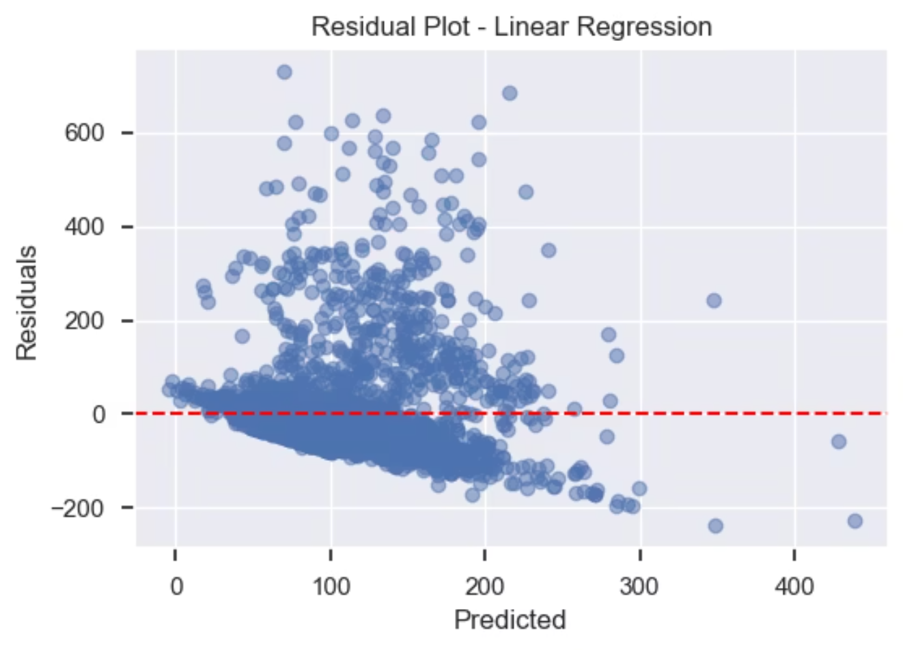
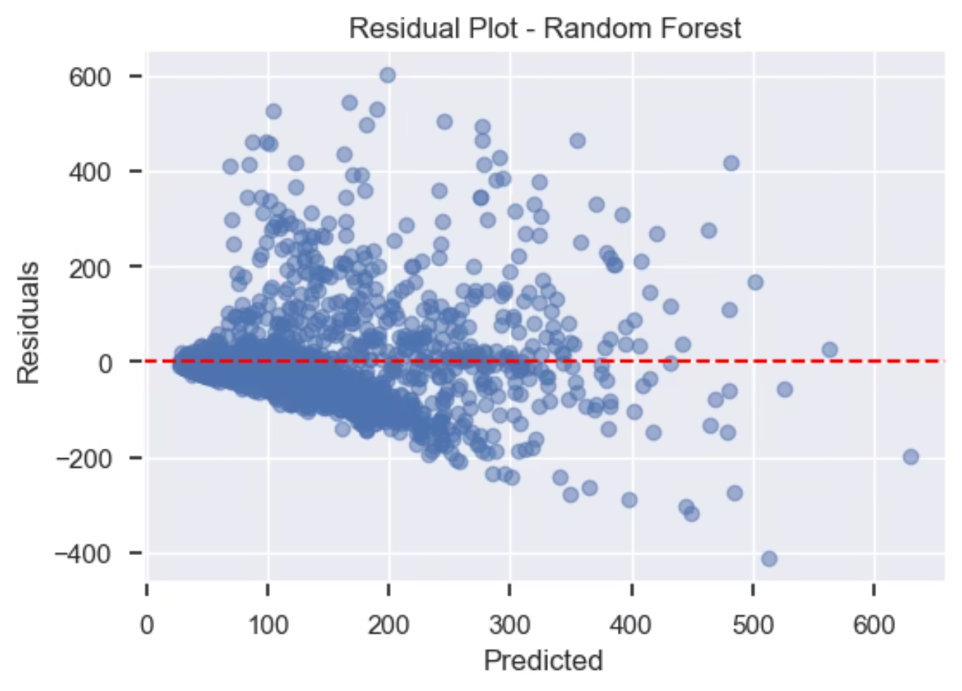
Residual Plot Analysis :
We can visualize residual plot to see how well estimators’ regression lines predicted and see how errors distributed around line , in example we compare random forest (best model) to linear regression (worst model) , we can see how well random forest estimated line between data dots that have same amount of error on top of the line and bottom of it , But in linear regression we can easily detect the underfit model because the amount of data error on top of the line are way more than the bottom .

Slide 25
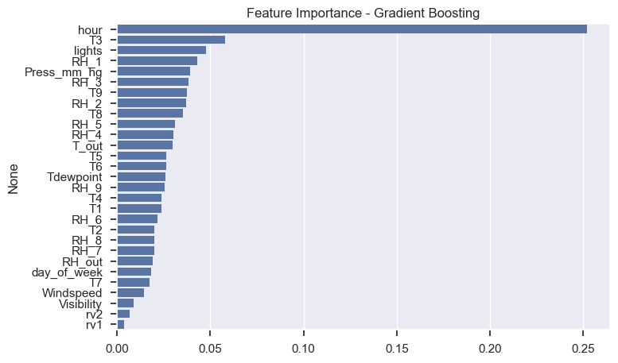
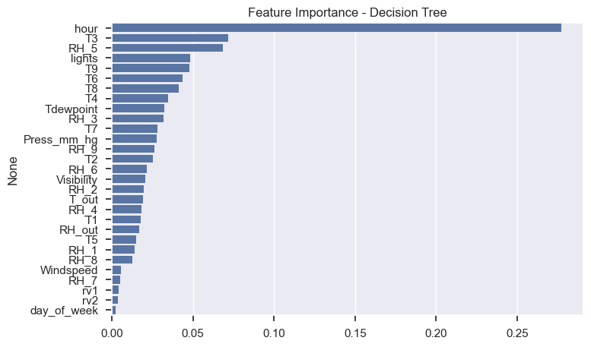
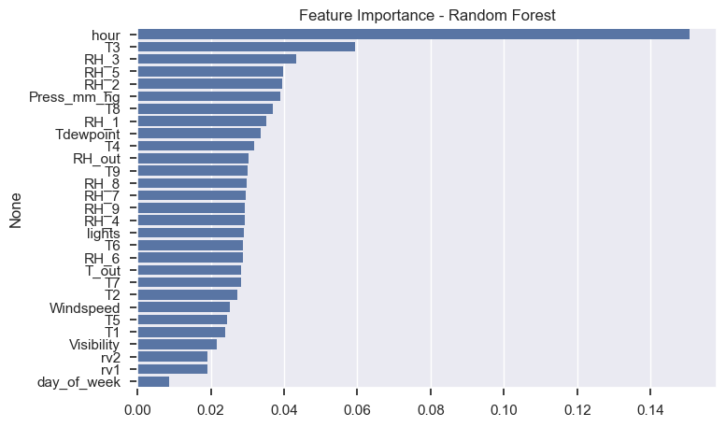
Feature Importance for Tree-Based Models :
We can also visualize feature importance to each model , in example we checked for Decision Tree , Random Forest and Gradient Boosting .
as we see we have a fair amount of attention between each feature by random forest which tried to used as much as possible from all predicators to make best estimation.

Slide 26
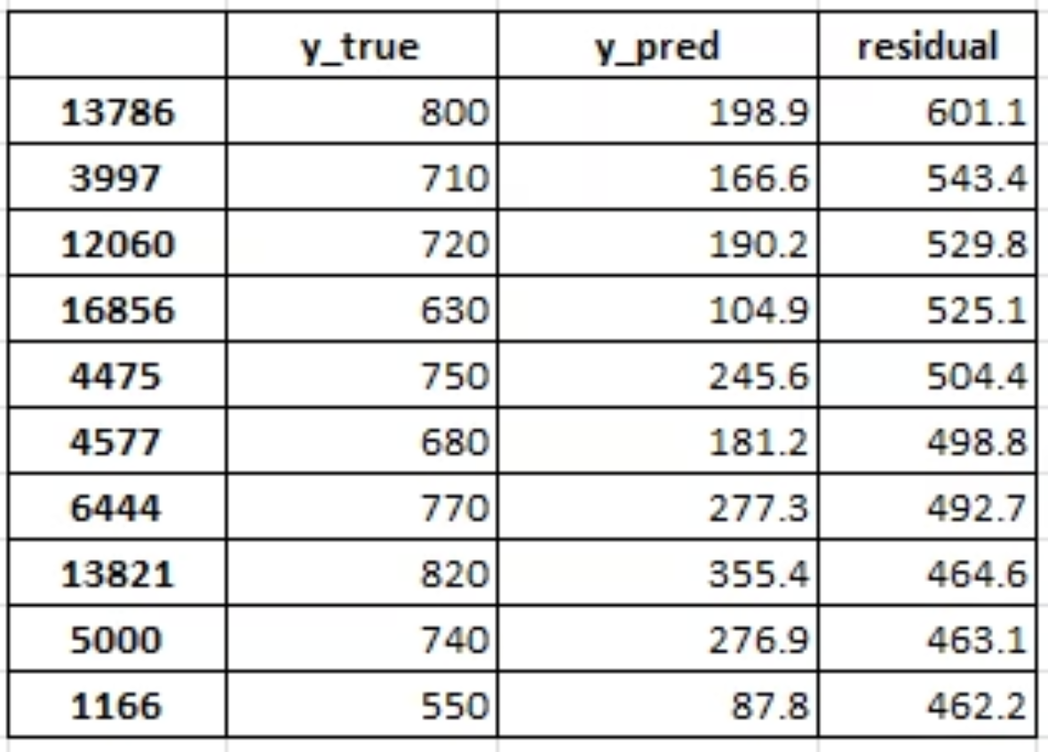
9. Error Analysis & interpretation :
We can bring our target data as label and the predicted amount of model to calculate residual , after that we can sort these residuals to see the top errors . in example we calculate it for our best model Random Forest . we can observe the index of our top errors , we may considerate it for further enhancements to identify patterns and handle them for better prediction .

Slide 27
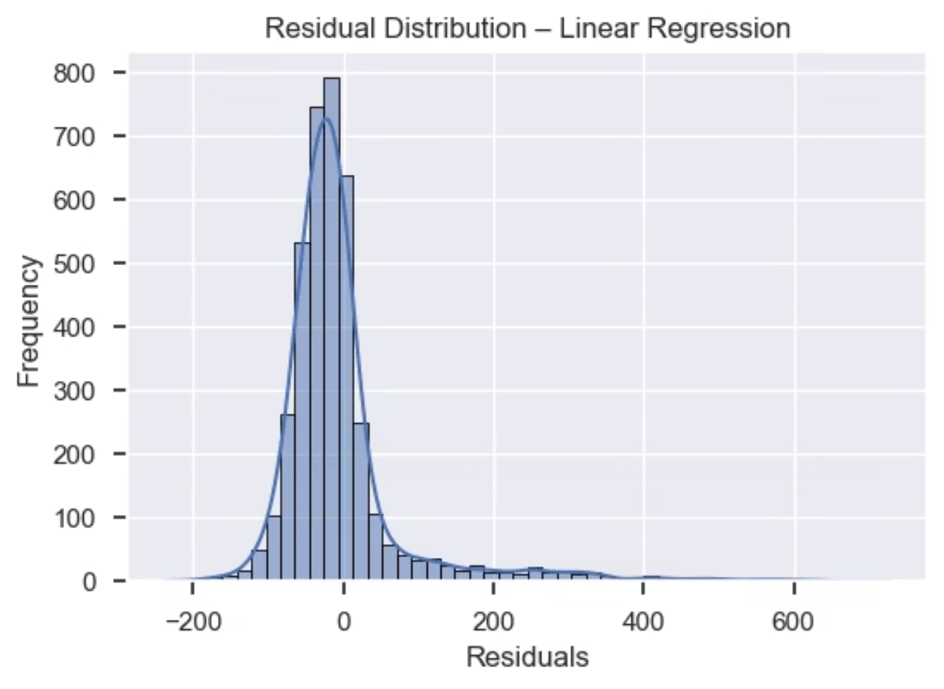
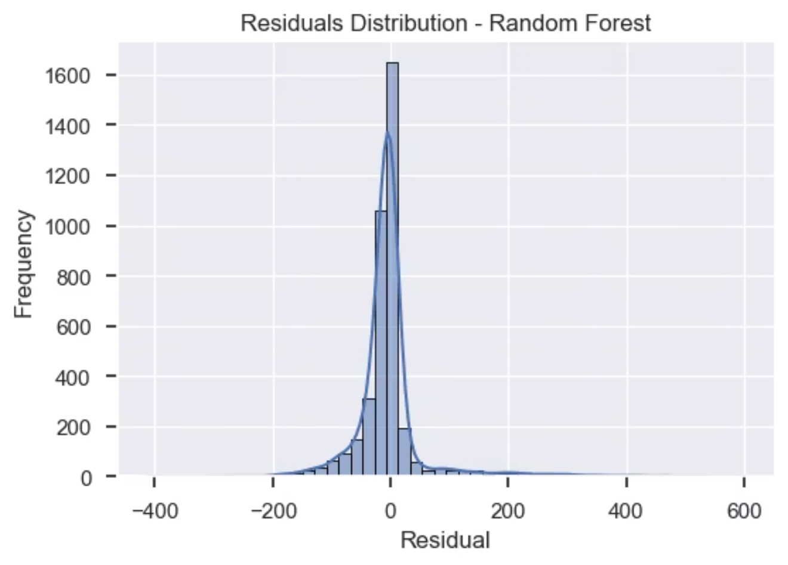
Residuals Distribution
The residual distribution for Linear Regression shows a wide spread and noticeable asymmetry, indicating that the model is unable to capture the nonlinear structure of the data and produces systematic errors.
In contrast, the Random Forest residuals are more concentrated around zero and display a more symmetric distribution, suggesting improved predictive accuracy. The residuals-versus-predicted plot shows no strong pattern, indicating limited heteroscedasticity and a better overall model fit.

Slide 28



Reflection & Conclusions
As we conclude this project, it's vital to summarize our findings, understand the trade-offs made, and acknowledge the limitations of our approach. This reflection provides a comprehensive view of the model's performance and areas for future improvement.
Key Findings
Ensemble methods (Random Forest, Gradient Boosting) consistently delivered the best performance across MAE, RMSE, and R².
Nonlinear models like Polynomial Regression and SVR showed improvements over baseline linear models but were surpassed by ensembles.
Linear regression offered a transparent baseline and valuable insights into feature coefficients.
Trade-offs
Accuracy vs. Interpretability: Linear models are simple and interpretable but less accurate for complex nonlinear relationships, whereas ensemble models achieve higher accuracy at the cost of interpretability.
Complexity vs. Training Time: Gradient Boosting and Random Forest models, while powerful, demanded significantly longer training times compared to simpler linear and polynomial regression approaches.
Limitations
Dataset Scope: The analysis relied on limited data (~4.5 months) from a single low-energy house in Belgium, which may impact generalizability to other contexts.
Missing Features: The absence of explicit occupancy data might have restricted the models' ability to capture certain consumption patterns.
Temporal Dynamics: The time-series aspect of energy consumption was only partially addressed using hour and day-of-week features, leaving room for more advanced temporal modeling.

